Slide 1
Yelp Rating Predictions Based on User Review Enhanced Collaborative Filtering
Milestone 2
Group 11
Yifei Xu, Xu Feng, Kai Liu, Wensi Fu

Slide 2
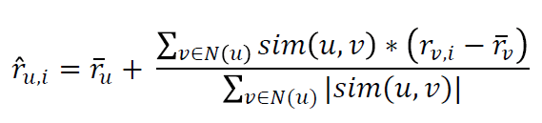
Problem Description & Challenges
Problem description
Increase the accuracy of the user rating prediction for better recommendation
Collaborative filtering (KNN)
Dataset
Yelp Data Set Challenge 1.6M reviews; 366K users; 61K businesses
Challenges
Analysis of text reviews
Similarity measurement
Text information + numerical rating
Conflict between numerical rating and review content
+ Review info
Notes:
For example, different user may care about different aspects.

Slide 3
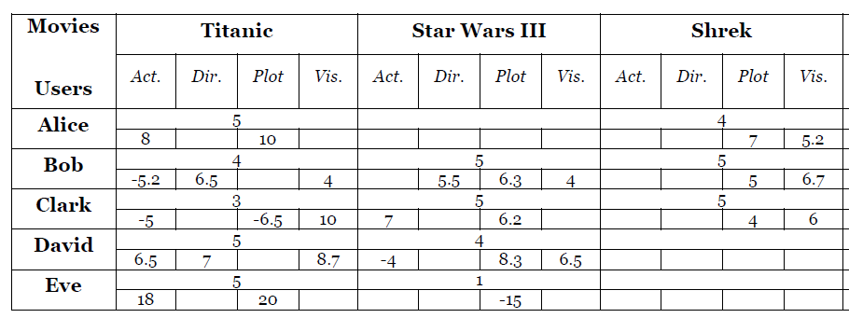
urCF User Review Enhanced Collaborative Filtering
Objective How to combine score rating and text review
Approach
Extracted opinions on different features
Proposed a new weighting scheme to measure the priority of item features
Integrated features in similarity calculation
Data set Yahoo! Movies 49562 reviews/ratings on 735 movies from 544 users.
Results Improvement of 6.178% in MSE over the baseline
Strength The novel user feature priority weighting scheme; Integrate features in similarity calculation
Weakness Cannot deal with matrix sparsity
Usefulness Incorporate the text review information in the calculation of similarity in KNN | feature priority weighting scheme
Z. Zhang et al., Americas Conference on Information Systems, Savannah, 2014, pp. 1–11.

Slide 4
Explicit Factor Models for Explainable Recommendation based on Phrase-level Sentiment Analysis
Objective Extract explicit user opinions on different features to make explainable recommendations
Approach
Sentiment Lexicon Construction (Feature, opinion, sentiment polarity)
User-feature attention matrix and item-feature quality matrix
Integrated explicit and implicit features to build factorization models for rating prediction
Combined the two ratings to make explainable recommendations and disrecommendations
Data set Yelp (English) | DianPing (Chinese)
Testing latest 5 or 10 reviews from each user
Training other reviews, 5-fold cross validation
Y. Y. Zhang et al., in Sigir, 2014, pp. 83–92.

Slide 5
Explicit Factor Models for Explainable Recommendation based on Phrase-level Sentiment Analysis
Result RMSE ↓0.01 | Normalized Discounted Cumulative Gain ↑0.023 | Accuracy ↑0.011
Strength
Included both explicit and implicit factors for higher accuracy
Explainable recommendation
Weakness
Too many parameters to tune
No interactions between features
Usefulness
Phrase-level feature and opinion extraction
Calculation of the user-attention matrix
Feature words clustering
Y. Y. Zhang et al., in Sigir, 2014, pp. 83–92.

Slide 6
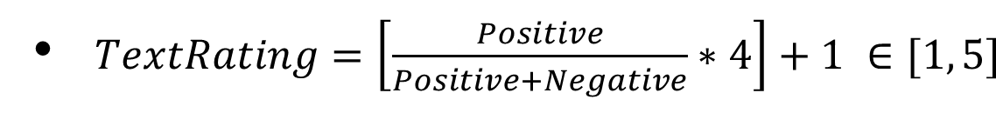
Improving Rating Predictions using Review Text Content
Objective Improved recommendation accuracy by just using reviews
Approach
12 [feature, sentiment] pairs
KNN
Data set 50K restaurant reviews from Citysearch New York
Results MSE 1.36%
Strength Straightforward | Standardized user rating based on reviews
Weakness Ignored priority of features | Ignored conflict sentences
Usefulness Text rating approach
N. Jakob et al., in Proceedings of the 1st international CIKM workshop on Topic-sentiment analysis for mass opinion, 2009, pp. 57–64.

Slide 7
Comparative Analysis
Paper # | Feature extraction | CF method | Methods to use texts | Feature priority
1 | Sentence-level | KNN | Similarity calculation | Yes
2 | Phrase-level | Matrix Factorization | Matrix construction | Yes
3 | Sentence-level | KNN | Text rating | No
OUR | Phrase-level | KNN | Similarity calculation + text rating | Yes

